Slide 1
Automation done right
Sean Sparkman
@seansparkman
Microsoft MVP and Xamarin MVP
sean.sparkman@gmail.com

Slide 2
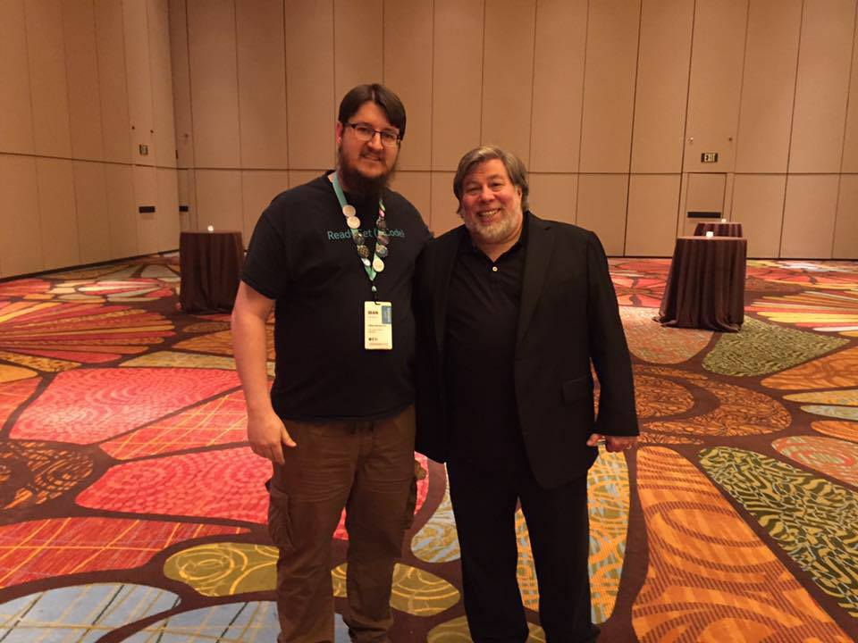
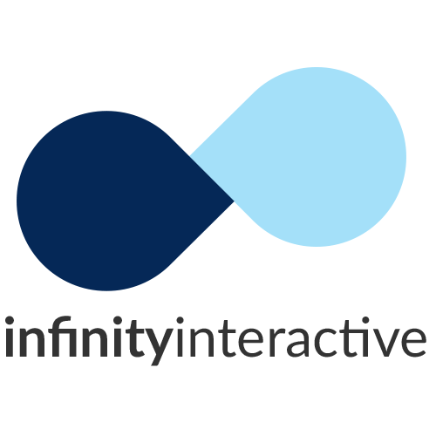
Sean Sparkman
Father, Husband, President of DFW Mobile .NET User Group, Xamarin MVP, Microsoft MVP, and Team Lead and Senior Developer at @IInteractive
Email: sean.sparkman@iinteractive.com
Twitter: @seansparkman

Slide 3
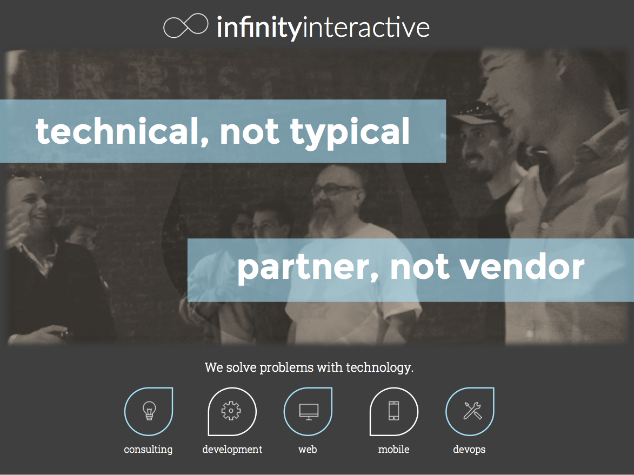

Slide 4

When: Third Wednesday of the Month
Time: 6:30 PM
Where: Improving Enterprises
5445 Legacy Dr.
Suite 100
Plano, TX
http://www.dfwmobile.net
@DFWMobileNet

Slide 5
Notes:
100% Open Source
Extendable, Create your own build steps.
Claims to have saved developers almost 5 million developers hours in the last 16 months
Focuses on automation of iTunes Connect, Apple Developer Portal and Google Play Store tasks
It’s a collection of utilities

Slide 6


Slide 7
Notes:
Ruby is an object oriented language
Ruby was born out of a dislike like for Perl. The creator described Perl as a toy language.
Ruby was originally conceived in 1993!
First released in 1995 in Japan and more popular than Python there

Slide 8
Notes:
spaceship exposes both the Apple Developer Center and the iTunes Connect API. This fast and powerful API powers parts of fastlane, and can be leveraged for more advanced fastlane features. Scripting your Developer Center workflow has never been easier!
Up until now, the fastlane tools used web scraping to interact with Apple's web services. With spaceship it is possible to directly access the underlying APIs using a simple HTTP client only.

Slide 9
Creates an application in iTunes Connect and Developer Portal
Creates App Groups
Enables and disables services for an application

Slide 10
Fetch or generate the latest available code signing identity
Creates private key
Creates signing request
Generate, download and install certificates
Import all generated files to your keychain
Notes:
No more using Keychain Access or Developer Account Portal Wizards
Existing certs and privates cannot be downloaded, so the app can get those

Slide 11
Generates Provisioning Profiles
Supports App Store, Ad Hoc, Development and Enterprise Provisioning
Create, Repair, Renew and Download
Better control than XCode

Slide 12
Easily sync your certificates and profiles across your team using git
Uses cert and sigh tools to generate and manage your profiles and certificates
Stores your certificates and profiles with encryption in a git repo
Notes:
You have full control over what happens
You have access to all the certificates and profiles, which are all securely stored in git
You share one code signing identity across the team to have fewer certificates and profiles
Xcode sometimes revokes certificates which breaks your setup causing failed builds
More predictable builds by settings profiles in an explicit way instead of using the Automatic setting
It just works
You'll be asked to enter the URL to your Git repo. This can be either a https:// or a git URL. (If your machine is currently using SSH to authenticate with Github, you'll want to use a git URL, otherwise you may see an authentication error when you attempt to use match.) fastlane match init won't read or modify your certificates or profiles.
fastlane match change_password
openssl aes-256-cbc -k "<password>" -in "<fileYouWantToDecryptPath>" -out "<decryptedFilePath>" -a –d
Both your keys and provisioning profiles are encrypted using OpenSSL using a passphrase.
Storing your private keys in a Git repo may sound off-putting at first. We did an in-depth analysis of potential security issues and came to the following conclusions:

Slide 13
Makes sure your push notification certificates are valid
Can create new push notification certificates
Supports .pem, .cer, and .p12

Slide 14
Upload new app metadata and builds to iTunes Connect

Slide 15
Checks your app’s metadata before submitting to the store
Must already be setup and ready for submission in iTunes Connect

Slide 16
Works like delivery but delivers to Apple’s TestFlight
Can add and remove testers

Slide 17
Not compatible with Xamarin

Slide 18
Publish and update listings to the Google Play Store
Cannot create new listings
Google lies

Slide 19
Thank You! Questions?
Sean Sparkman
Microsoft MVP / Xamarin MVP
Team Lead / Senior Programmer
sean.sparkman@gmail.com
@seansparkman

